Slide 1
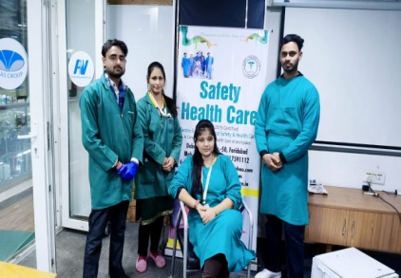
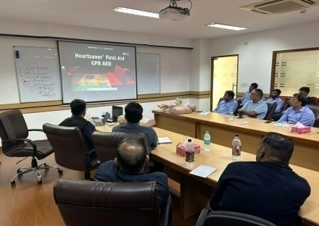
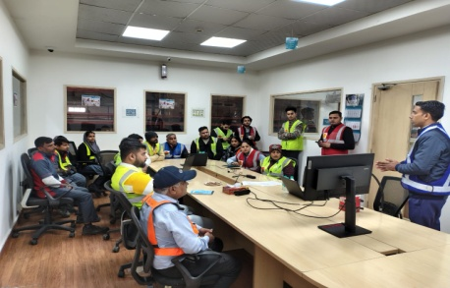
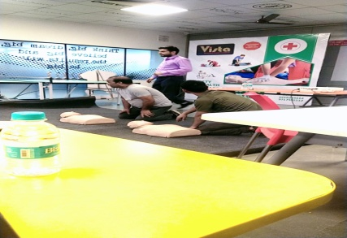
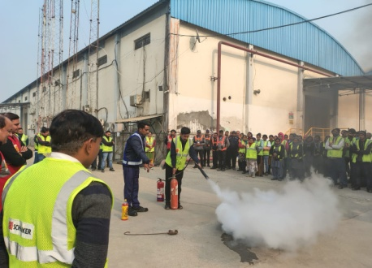
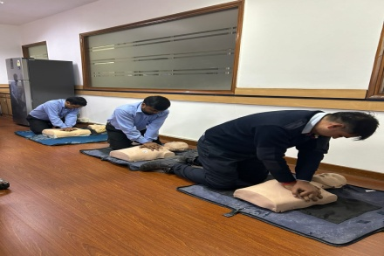
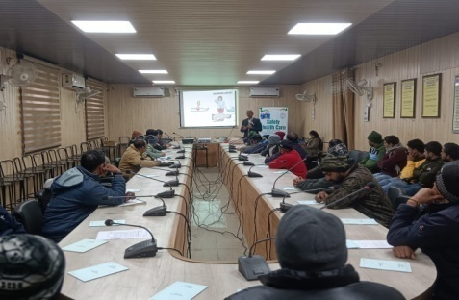
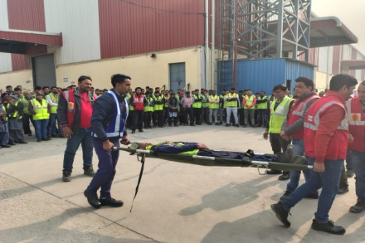
(Prevention is Better Than Cure) (Swasth Bharat-Surakshit Bharat) Safety Health Care (ISO 9001: 2015 Certified) (Udyam Certified) Centre For Occupational Safety & Health Care A Complete Occupational Health Care at Workplace

Slide 2
SAFETY HEALTH CARE, Faridabad
A GLIMPSE

Slide 3
Safety Health Care is designed with emphasis in providing the world class clinical services & diagnostic facilities for occupational diseases & Industrial Hygiene.
We would like to take opportunity to offer a comprehensive Onsite
Occupational medical examinations of your employees
Our core professionals will help Industrial authority to decide services including occupational health periodical medical examinations according to The Factories act 1948 requirement & exposure to employees for better utilization of company’s health budget.
We will rectify all compliance related to factories act as it’s a move for mutual benefits and long term relationship.

Slide 6
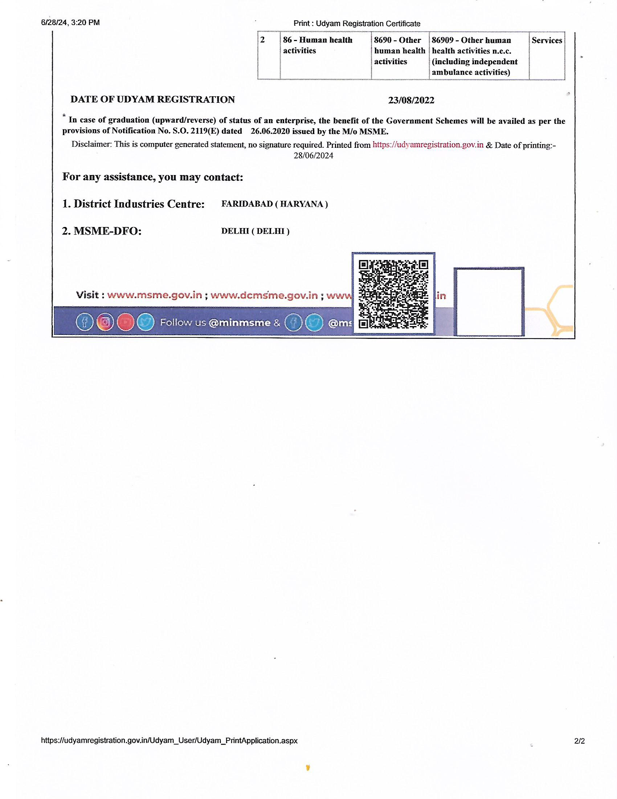

Slide 8
Safety Health Care
Core for Industrial Safety & Healthcare
Services & Benefits
Our professionals are well trained, experienced & expert in their field includes Occupational Consultants, Factory Medical Officers, Safety officers, Paramedical staff & Technicians. Our Corporate clients are various industries in Delhi NCR.
Our onsite services :
Pre – employment medical examination
Onsite Occupational Periodical Medical Examinations
Onsite Occupational Health Centre setup
Onsite digital X ray Chest
Pulmonary function test,
Audiometric hearing test,
Blood Sugar,
Blood Group
Blood pressure,
Body Fat Analysis,
Body mass index (BMI)
Eye Check up & Colour vision test
First aid training & First Aid Mock Drill
Health & Fitness Education programs

Slide 9
OUR PRECIOUS CLIENTS:
M/s Ashoka Distillers & Chemicals Pvt. Ltd., Palwal (Haryana)
M/s Pernod Ricard India Pvt. Ltd., Palwal (Haryana)
M/s Master Stroke Interiors Pvt. Ltd., Greater Noida (U.P)
M/s Ultratech Cement Ltd. Tanda Cement Works, Ambedkar Nagar (U.P)
M/s Ultratech Cement Ltd.SikandrabadCement Works,Sikandrabad (U.P)
M/s Ultratech Cement Ltd. Jhajjar Cement Works, Jhajjar (Haryana)
M/s Ultratech Cement Ltd., Panipat Cement Works, Panipat (Haryana)
M/s Ultratech Cement Ltd. Roorkee Cement Works, Roorkee (Uttarakhand)
M/s Ultratech Cement Ltd. Bara Cement Works, Khan Semra (U.P)
M/s Spack Automotives Pvt. Ltd. Greater Noida (U.P)
M/s Powerspack Automation Pvt. Ltd. Greater Noida (U.P)
M/s Alba Powerspack Tooling India Pvt. Ltd. Greater Noida (U.P)
M/s Cooper Standard India Pvt. Ltd. Ghaziabad (U.P)
M/s ABB India Ltd., Faridabad (Haryana)
M/s Orient Electric Ltd. I.A, Faridabad (Haryana)
M/s Lindstorm India Pvt. Ltd, Faridabad (Haryana)
M/s Sanden Vikas (India) Pvt. Ltd., Faridabad (Haryana)
M/s Sanden Vikas (India) Pvt. Ltd.,Ballabhgarh (Haryana)
M/s Sanden Vikas (India) Pvt. Ltd.Mathura Palwal Baghola (Haryana)
M/s India Forge & Drop Stampings Ltd., Faridabad (Haryana)
M/s Alchem International Pvt. Ltd. Ballabhgarh Faridabad (Haryana)
M/s Lauls Tata Steel NIT Faridabad (Haryana)
M/s Gowell Rubber Industries Pvt. Ltd. SGM Nagar Faridabad (Haryana)
M/s Lakhani Rubber Ltd., Faridabad (Haryana)
M/s PICL India Pvt. Ltd., Faridabad (Haryana)
M/s Sidwal Refrigeration Industries Pvt. Ltd., Faridabad (Haryana)
M/s Mehra Metal Component Pvt. Ltd., Faridabad (Haryana)
M/s Bharat Gears Ltd., Faridabad, (Haryana)
M/s GKN Drive Line Ltd., Faridabad (Haryana)
M/s GKN Drive Line Ltd. Dharuhera (Haryana)
M/s Hemla Creative Dyeing, Faridabad (Haryana)
M/s Micro Precision Products Pvt. Ltd., Palwal (Haryana)

Slide 10
M/s Sata Vikas India Pvt. Ltd. Palwal (Haryana)
M/s Pranav Vikas India Pvt. Ltd.,Palwal (Haryana)
M/s Namo Alloys Pvt. Ltd., Palwal (Haryana)
M/s QH Talbros Pvt. Ltd., Gurugram (Haryana)
M/s QH Talbros Pvt. Ltd. IMT Manesar (Gurugram)
M/s Cooper Standard India Pvt. Ltd., Bawal (Haryana)
M/s FMI Automotive Ltd., Manesar (Haryana)
M/s ISGEC Heavy Engineering Ltd., Rattangarh, (Haryana)
M/s ISGEC Heavy Engineering Ltd., Yamunanagar (Haryana)
M/s Parijat Industries India Pvt. Ltd., Ambala (Haryana)
M/s Aksh Optifiber Ltd., Bhiwadi (Rajasthan)
M/s Tecumseh Products India Pvt Ltd, Ballabhgarh, Faridabad (Haryana)
M/s Alchem International Private Limited, Ballabhgarh, Faridabad (Haryana)
M/s L&T constructions Pvt Ltd – IGI Airport Delhi Project
M/s Brawn Laboratories Ltd. Faridabad (Haryana)
M/s Best Agrolife Ltd. Gajraula, Amroha (U.P)
M/s Vibracoustic Noida Pvt. Ltd.
M/s Best Crop Science Gajraula (U.P)
M/s Punihani International Okhla Industrial (N.D)
M/s FMI Automotive Components Ltd. IMT Manesar (Gurugram)
M/s Vidyut Steel Tubes Industries Pvt. Ltd. Faridabad (Haryana)
M/s Asian Fine Cement Pvt. Ltd. Rajpura Patiala (Punjab)
M/s Asian Fine Cement Pvt. Ltd, Nalagarh, Baddi, Himachal Pardesh.
M/s Hella Lightining India Ltd., Udyog Vihar, Phase-1, Gurugram.
M/s Victora Tools , IMT, Faridabad.
M/s Victora Tools, Noida, U.P
M/s Womder Cements, Matanhail, Jhajjar.
M/s Whirpool India Ltd, NIT, Faridabad
M/s JBM Environment Management Pvt. Ltd. Sonipat*
*M/s Super Seals , (India ) Pvt Ltd. Faridabad
* M/s Maurya Udyog Ltd, Faridabad
* M/s Nipro Pharma Packing India Pvt Ltd, Meerut (U.P)
* M/s Diaki Axis Environment Pvt Ltd, Palwal, Haryana.

Slide 11
* M/s J.K Cements work Pvt Ltd, Ujjain (M.P)
* M/s Imperial Auto Industries Ltd, Faridabad
* M/s J.K Cemenets Pvt Ltd, Jhaajjar, Haryana
* M/s Vista Retail , Faridabad, Haryana
*M/s Indoautotect Ltd, Faridabad, Haryana
M/s Vardhman Recycling LLP, Faridabad, Haryana
M/s Penguin Random House India Pvt Ltd, Hapur(U.P)
M/s Leeds Lif e Science Pvt Ltd, Naraingarh, Haryana
M/s Kesar Appliance , IMT, Faridabad
M/s Indicold Pvt Ltd, Palwal, Haryana
M/s Starwire Pvt Ltd, Chainsa, Faridabad, Haryana
M/s Wonder Cements Ltd, Jhajjar, Haryana
M/s Wonder Cements Ltd, Aligarh (U.P)
M/s Gunno Fashion Pvt Ltd, Faridabad
M/s Rani Electrodes Ltd , Palwal, Haryana
M/s Northern Railways (Carriage & Wagon) Workshop , Yamunanagar.

Slide 12
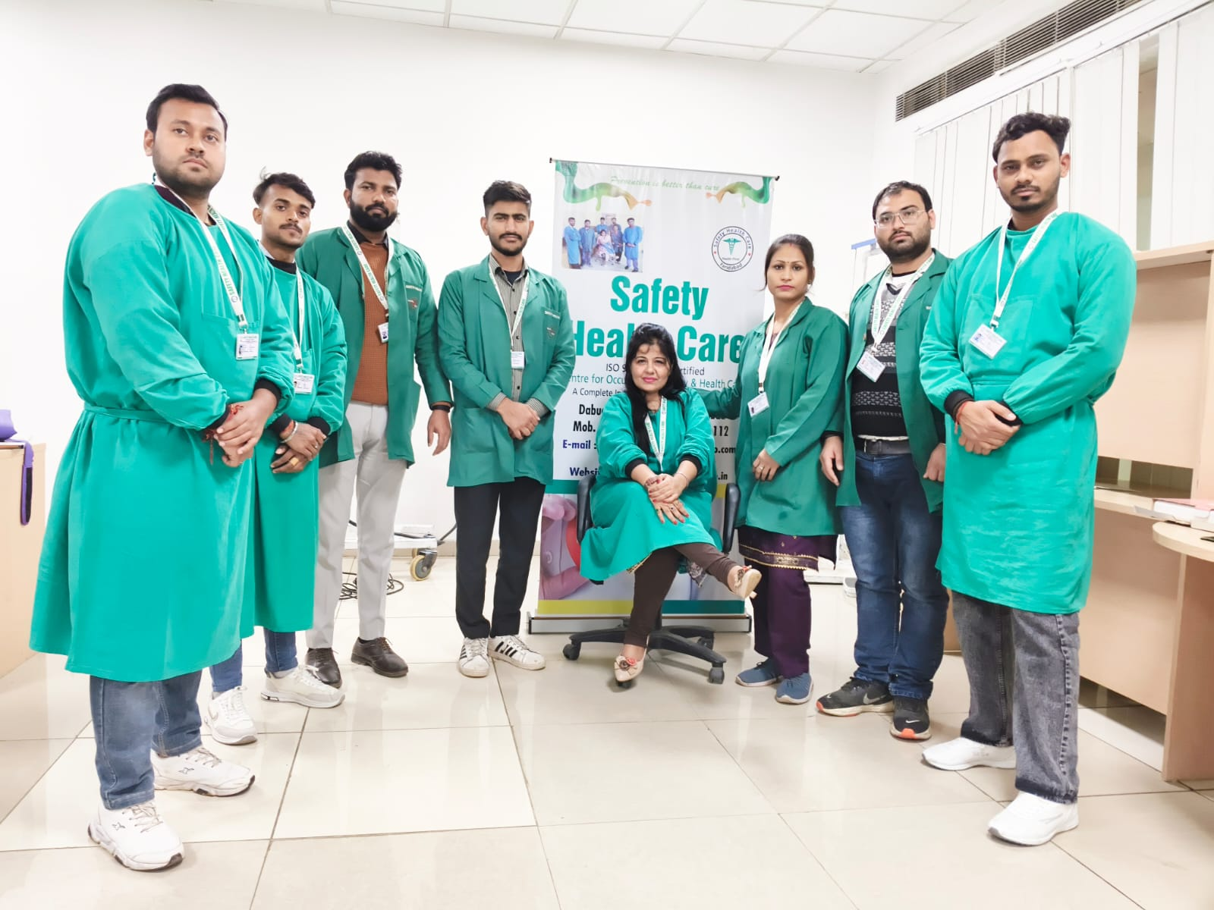

Slide 13
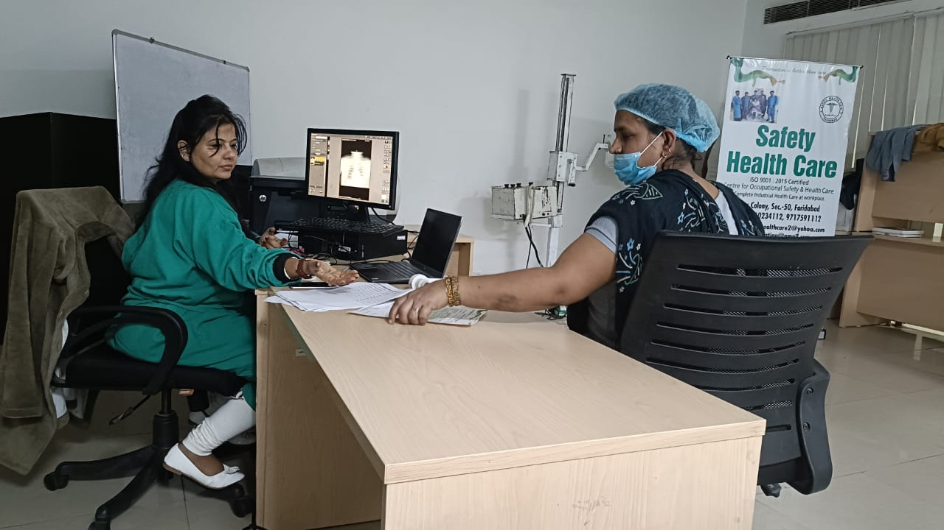

Slide 14
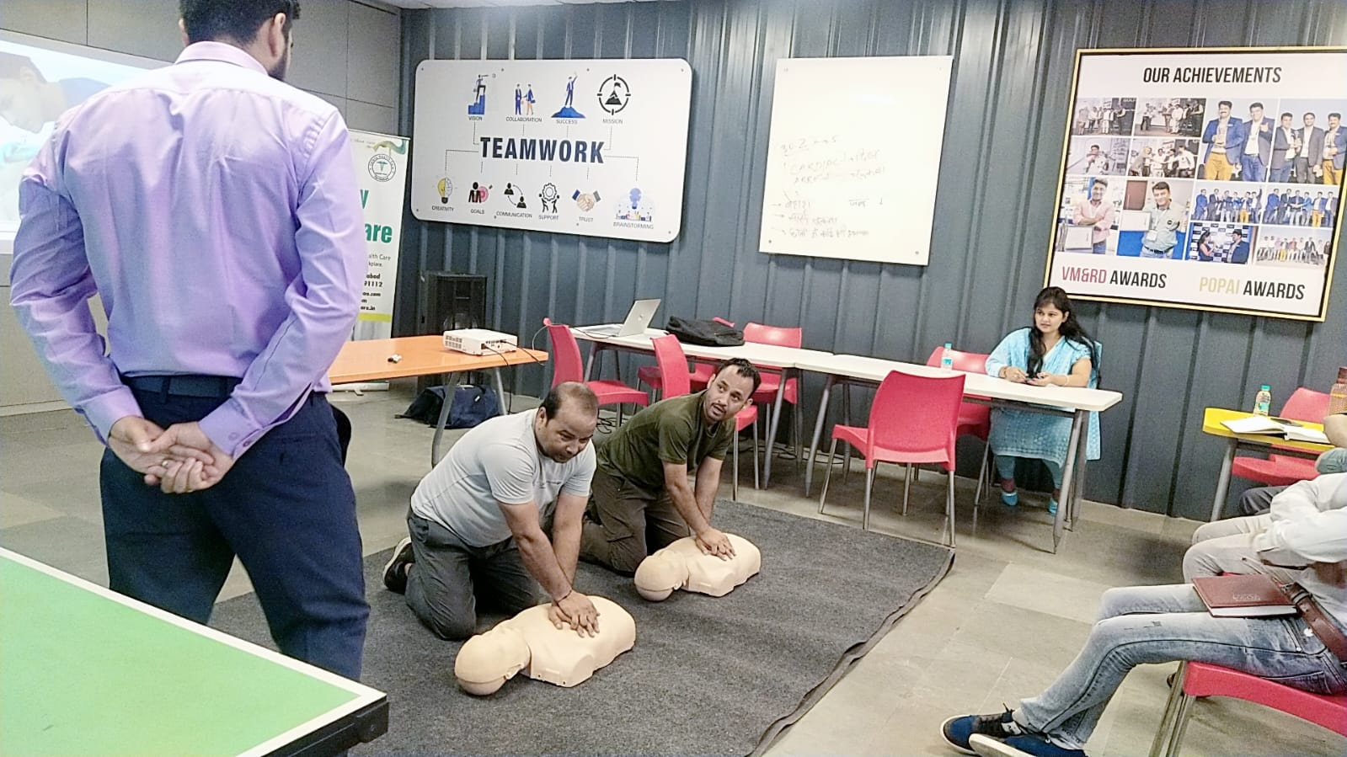

Slide 15
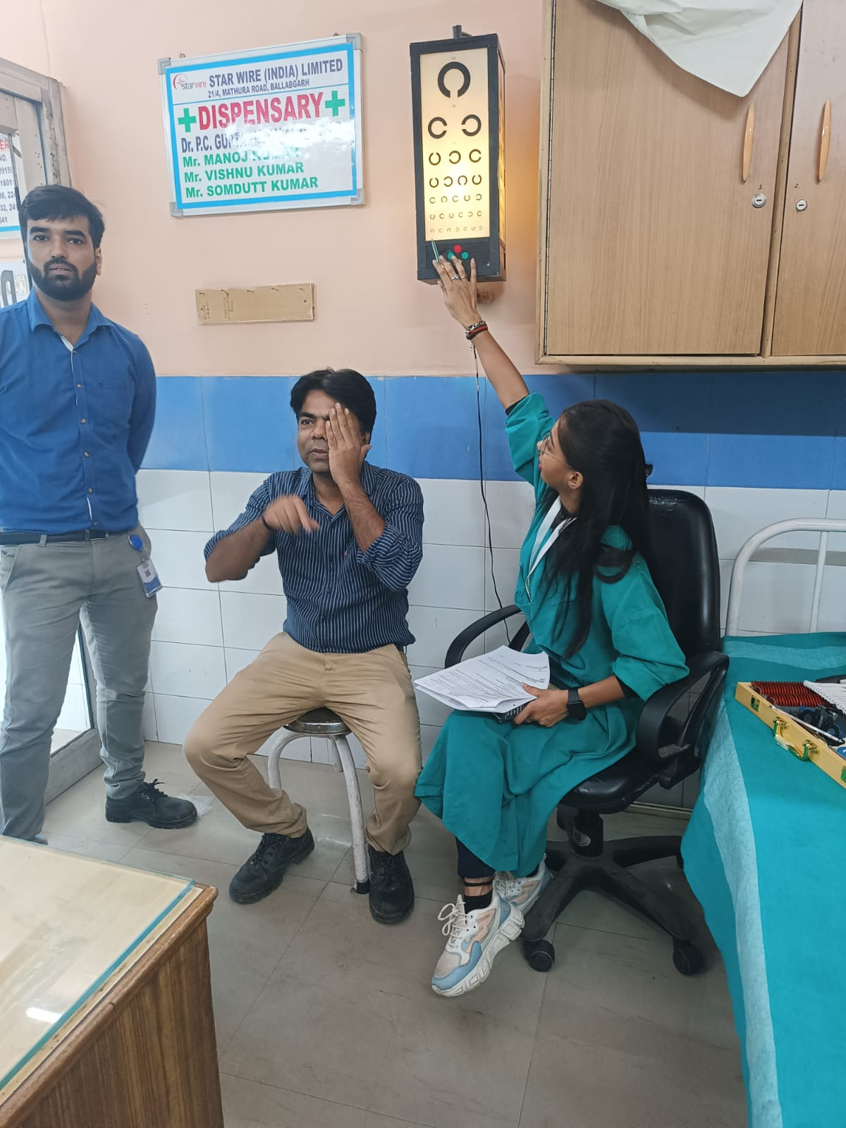

Slide 16
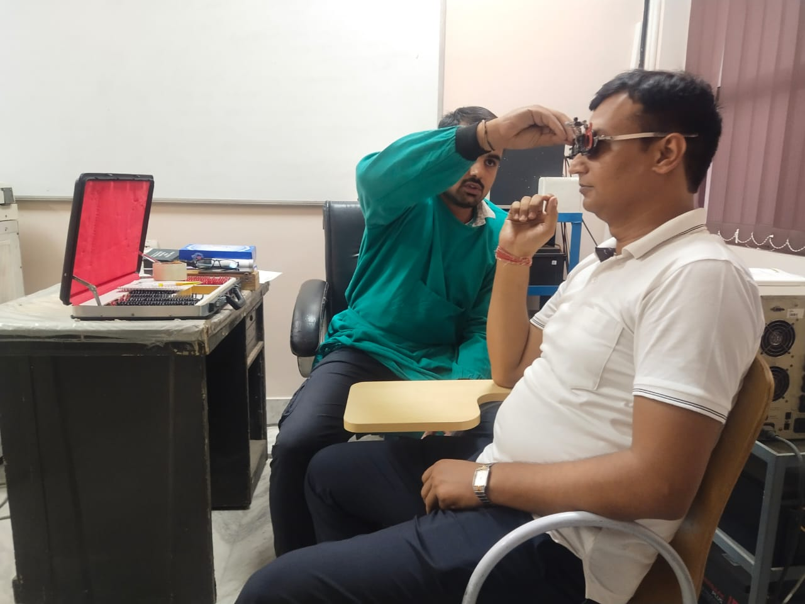

Slide 17
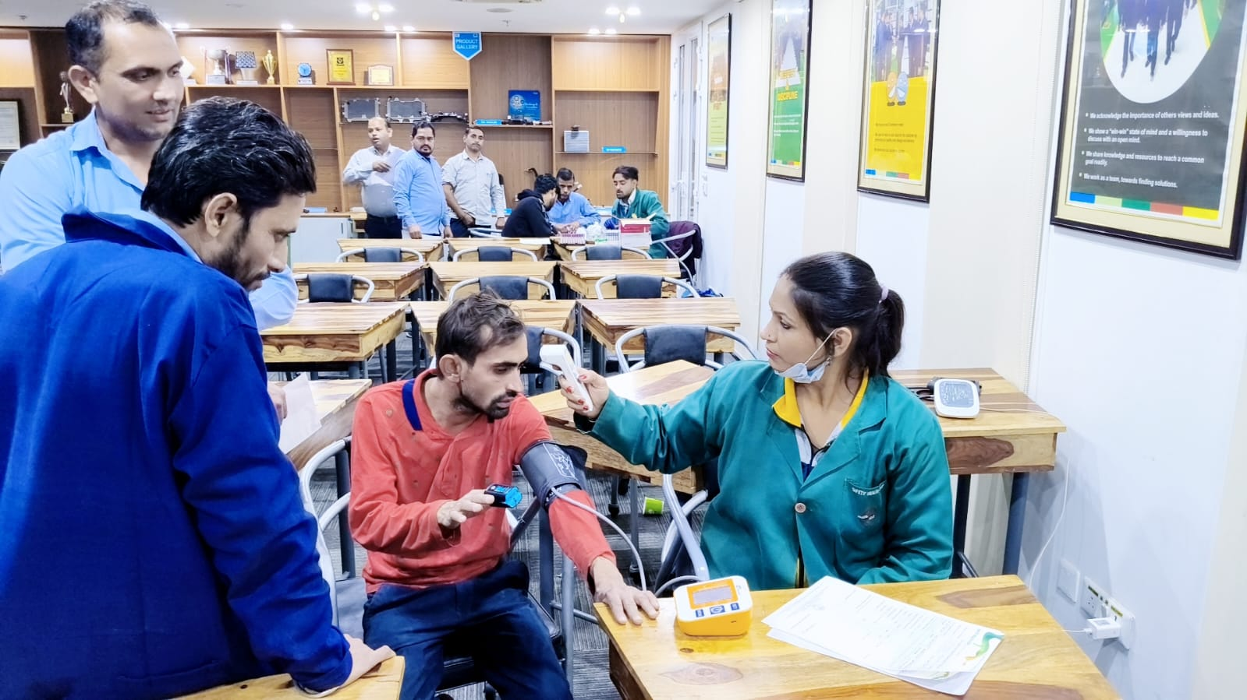

Slide 18
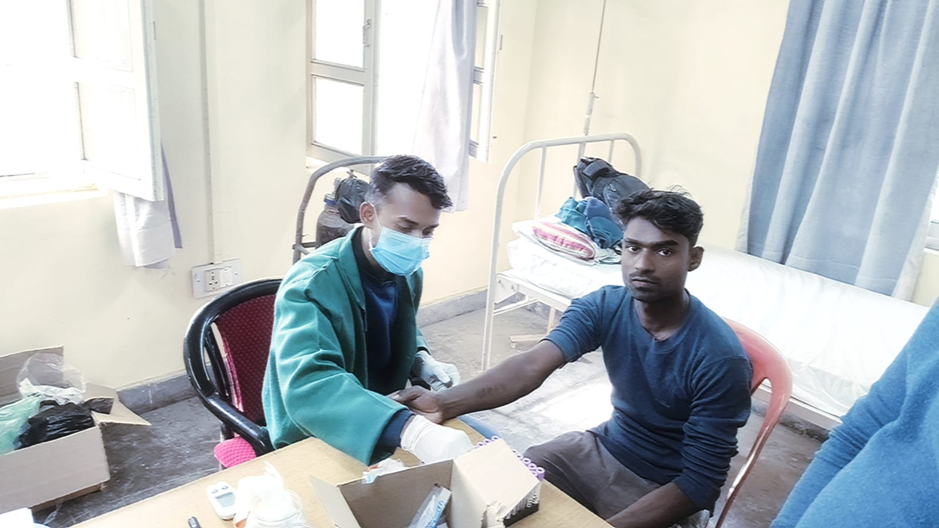

Slide 19
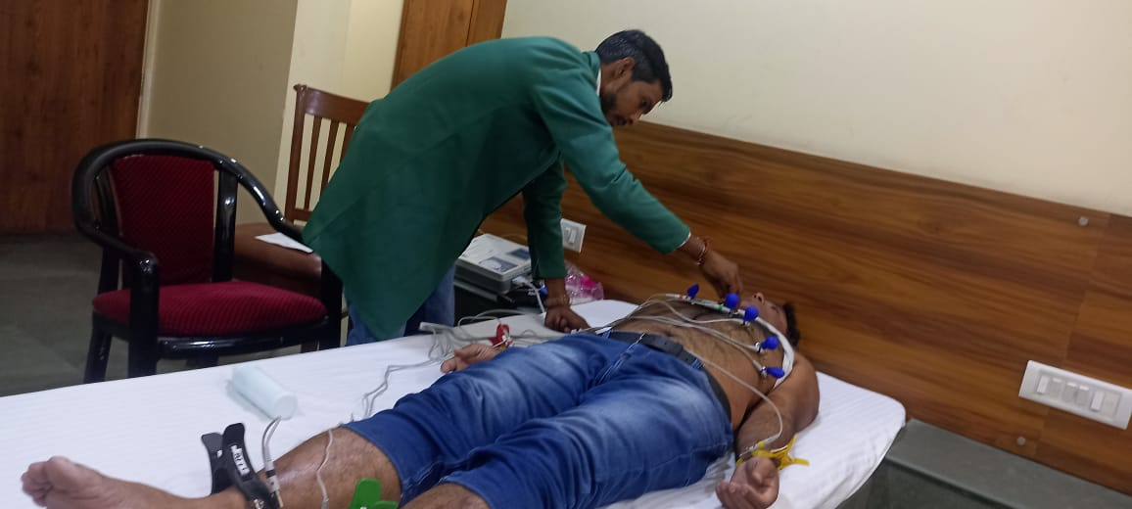

Slide 20
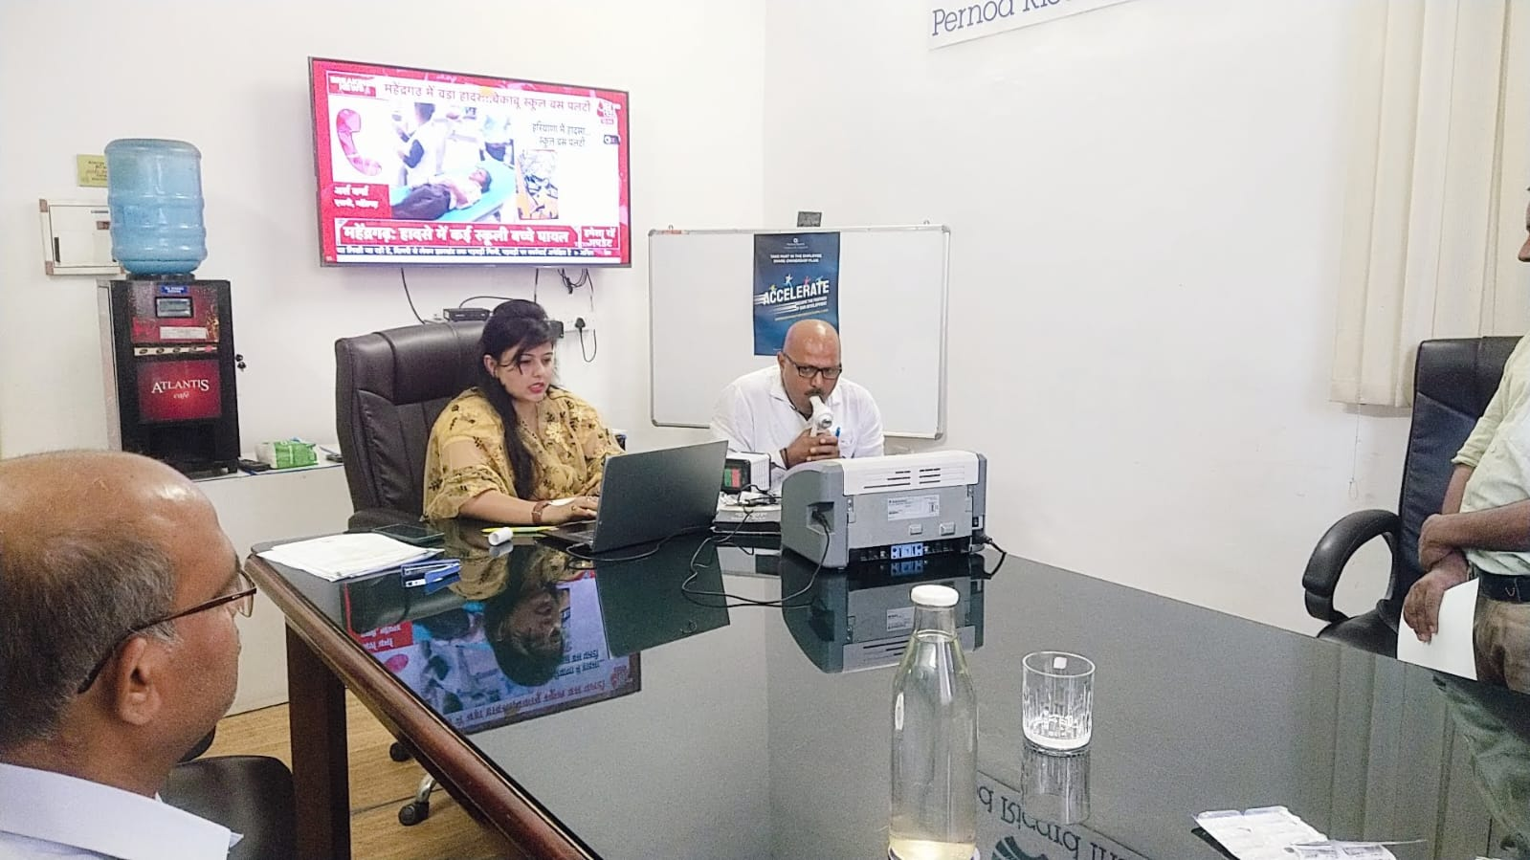

Slide 21
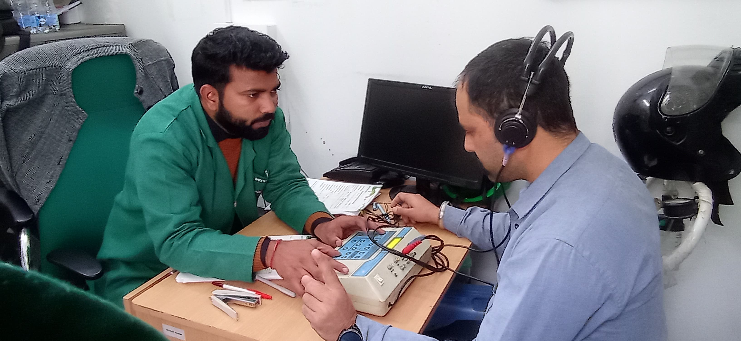

Slide 22
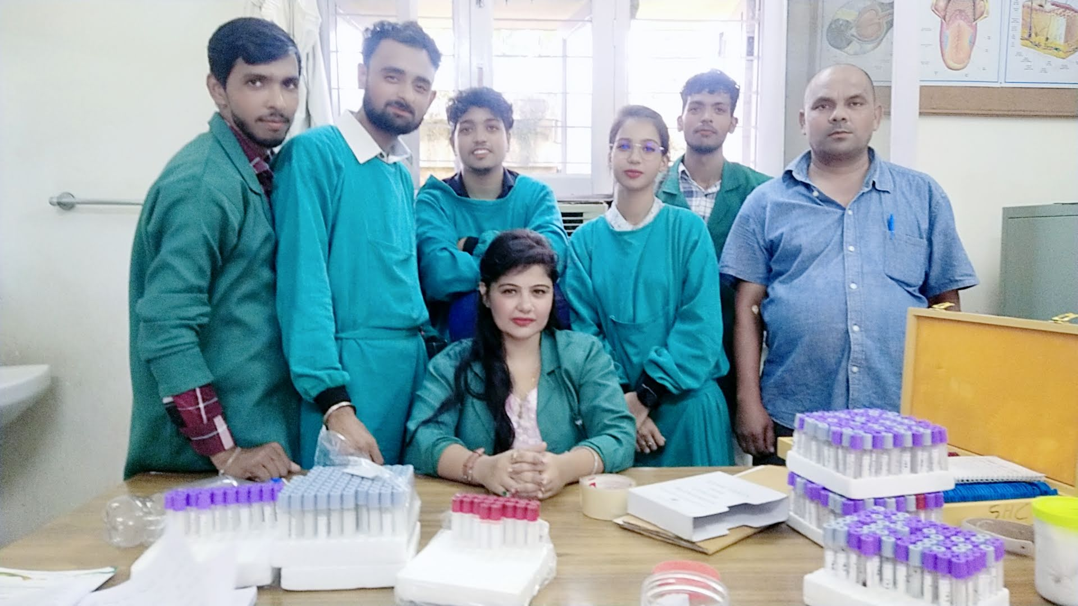

Slide 23
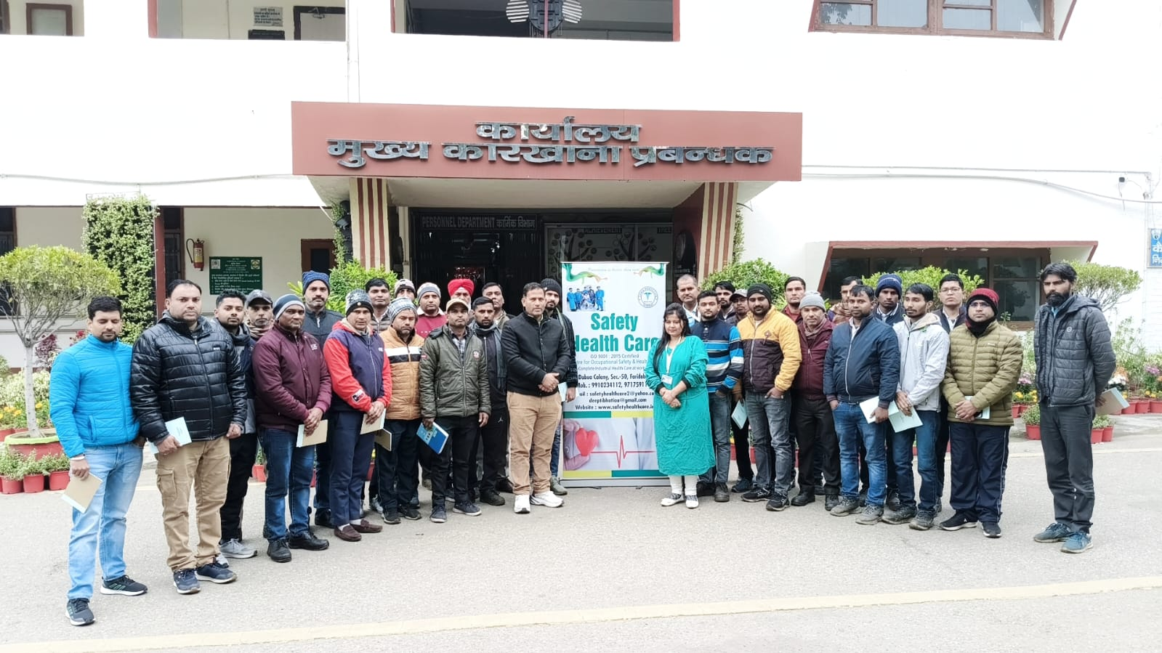

Slide 27
S

Slide 30
SAFETY HEALTH CARE, Faridabad
Helps in zero absenteeism of your employees
Helps in timely diagnosis of Occupational Diseases
Helps in proper Treatment of Employees
Helps in First Aid Management
Helps in rectifying the lacunas during Mock Drills
Helps in Compliances under various labour laws
All these things can be done by Periodical Medical Examinations

Slide 31
Safety Health Care,Faridabad Go Green, Help Others

